Slide 1

Introduction

Slide 2
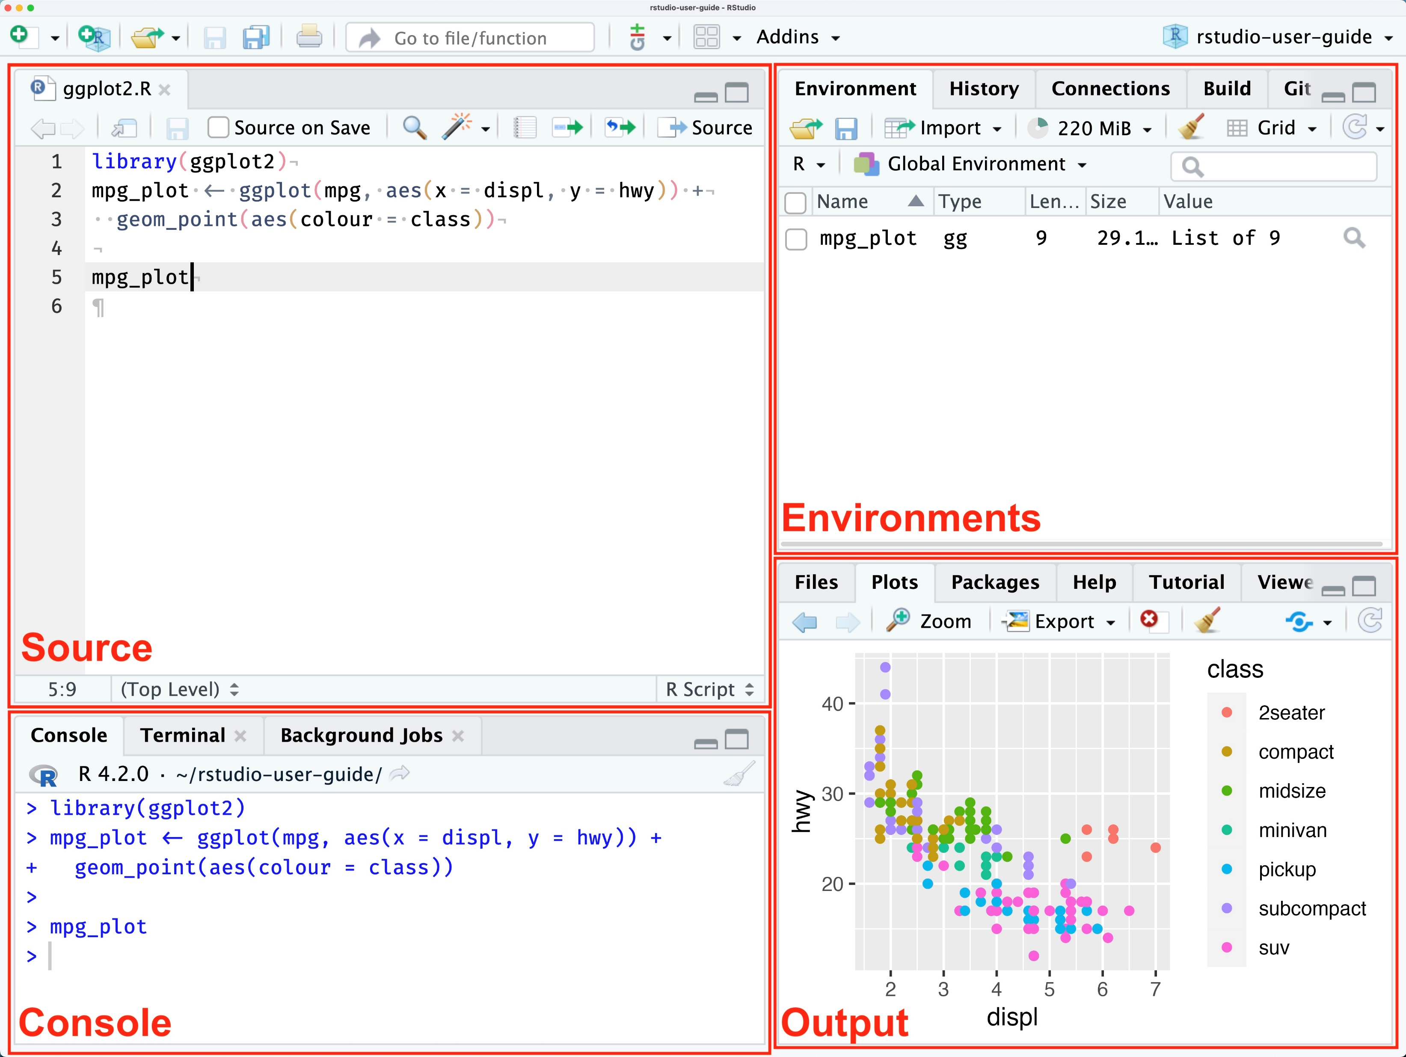
Rstudio Basics

Slide 3
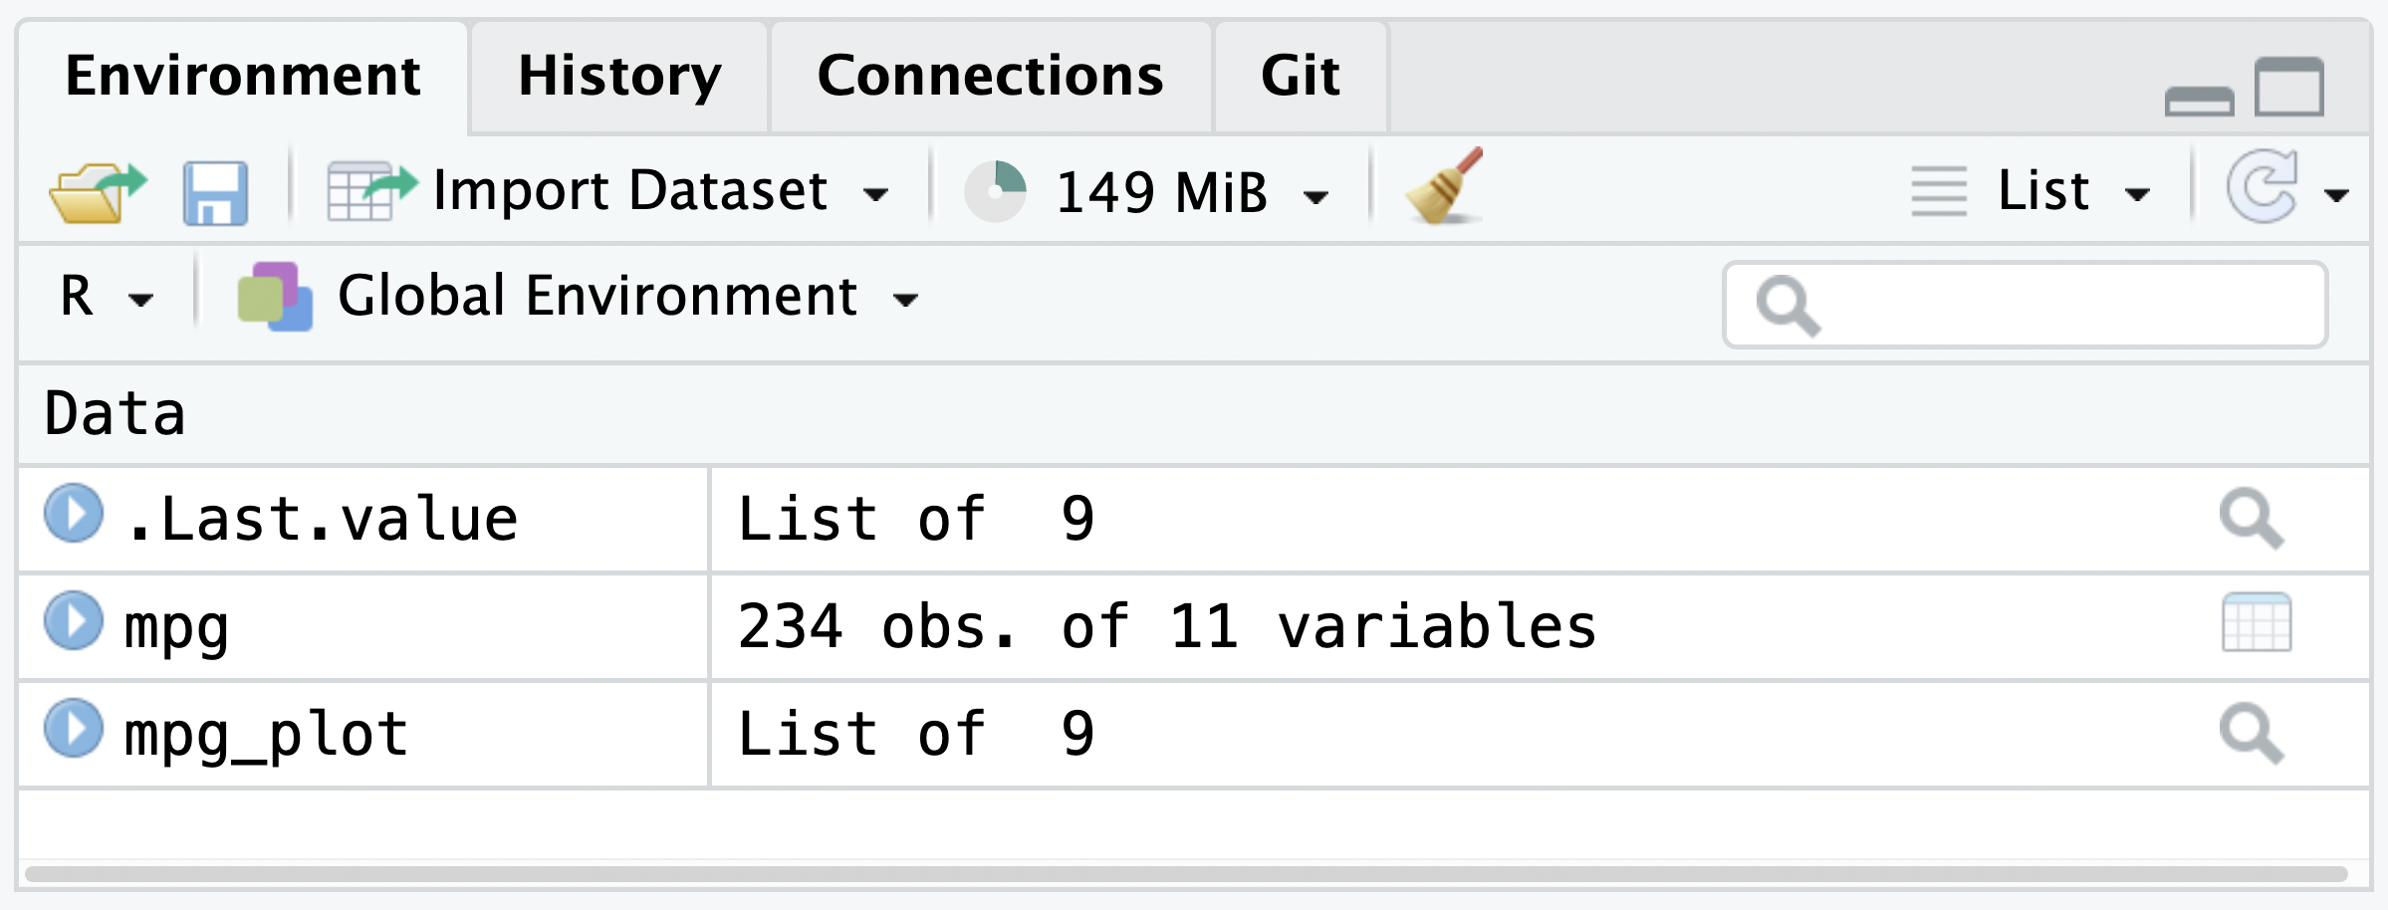
Environment

Slide 4
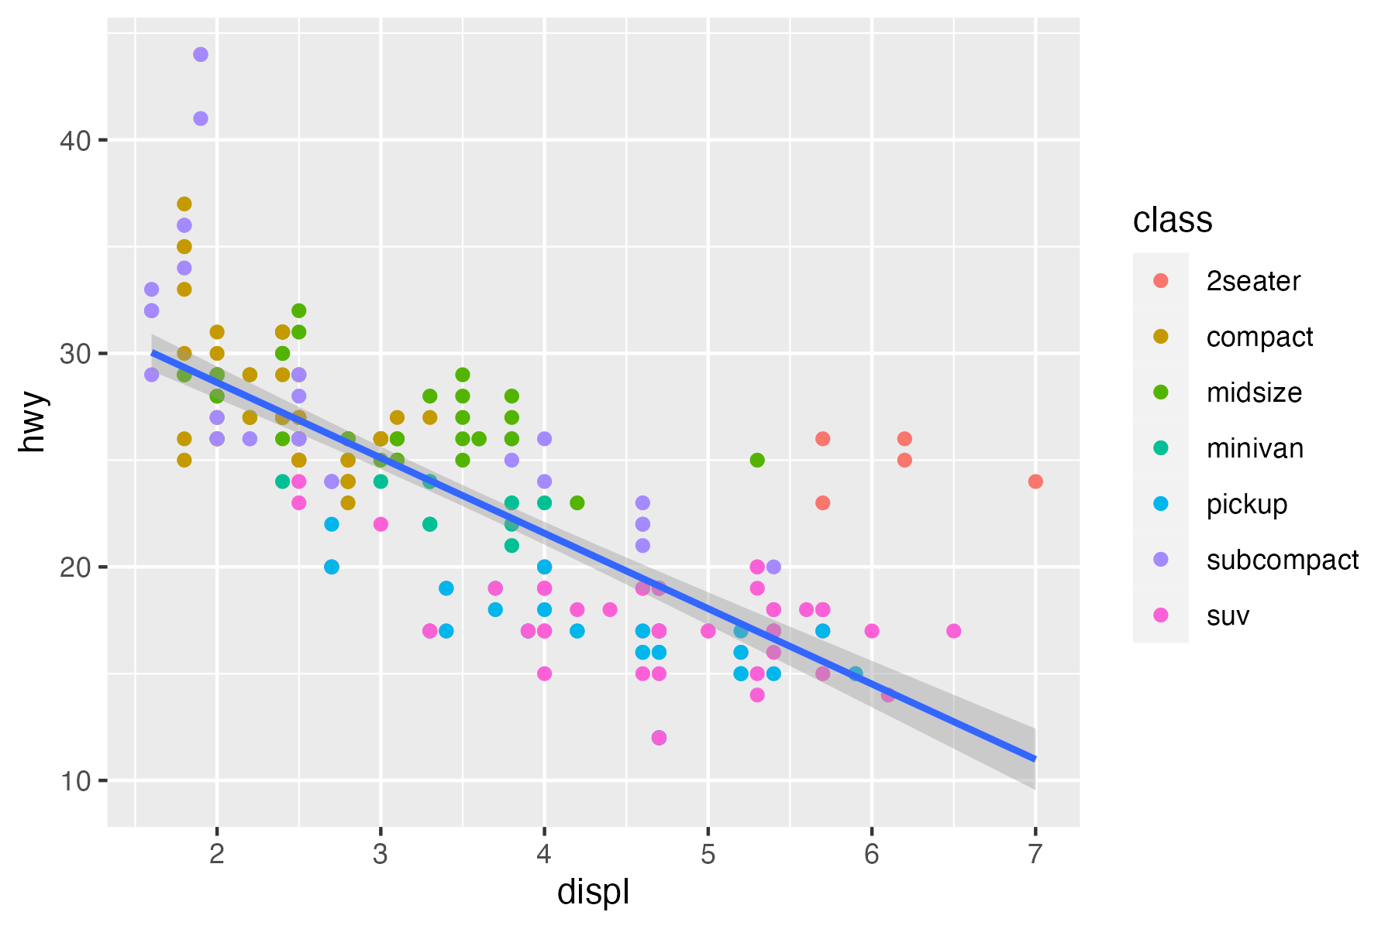
Outputs (plot)

Slide 5
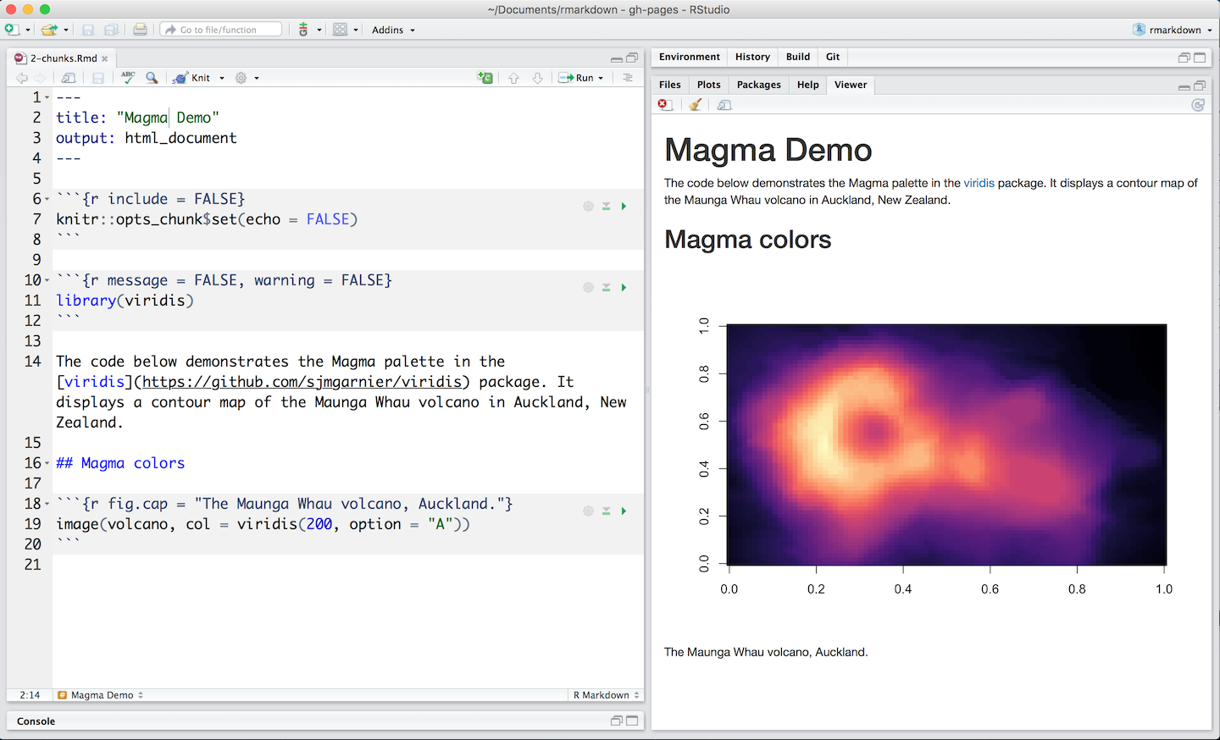
Markdown Code Chunks
Windows Shortcut: Ctrl + Alt + I
OS X: Cmd + Option + I

Slide 6

Transform Data with
Slides CC BY-SA RStudio

Slide 7
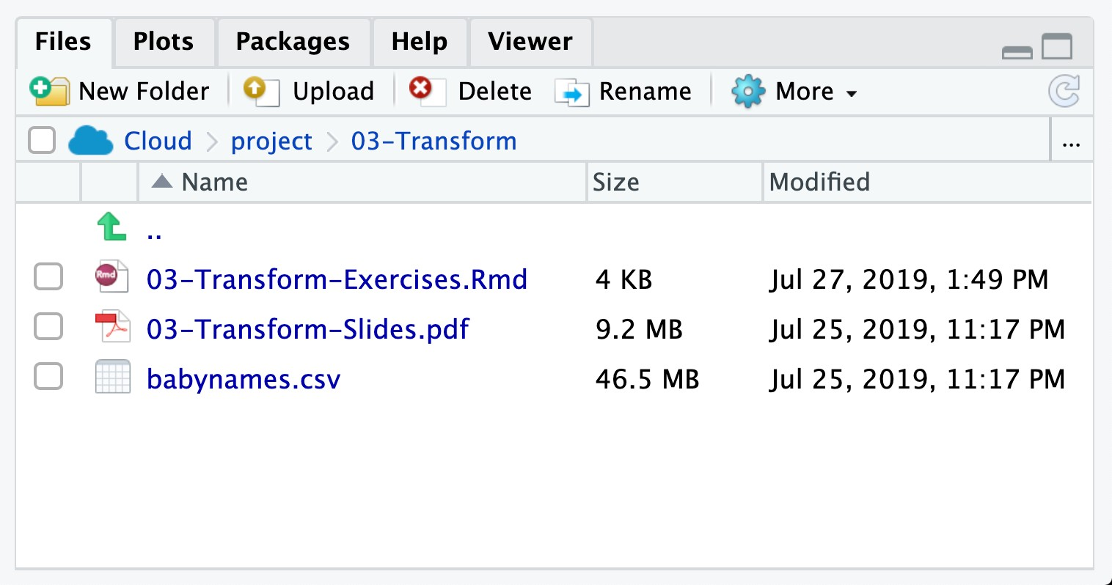
babynames.csv
Names and sex of babies born in the US from 1880 to 2017. 1.9M rows.

Slide 8
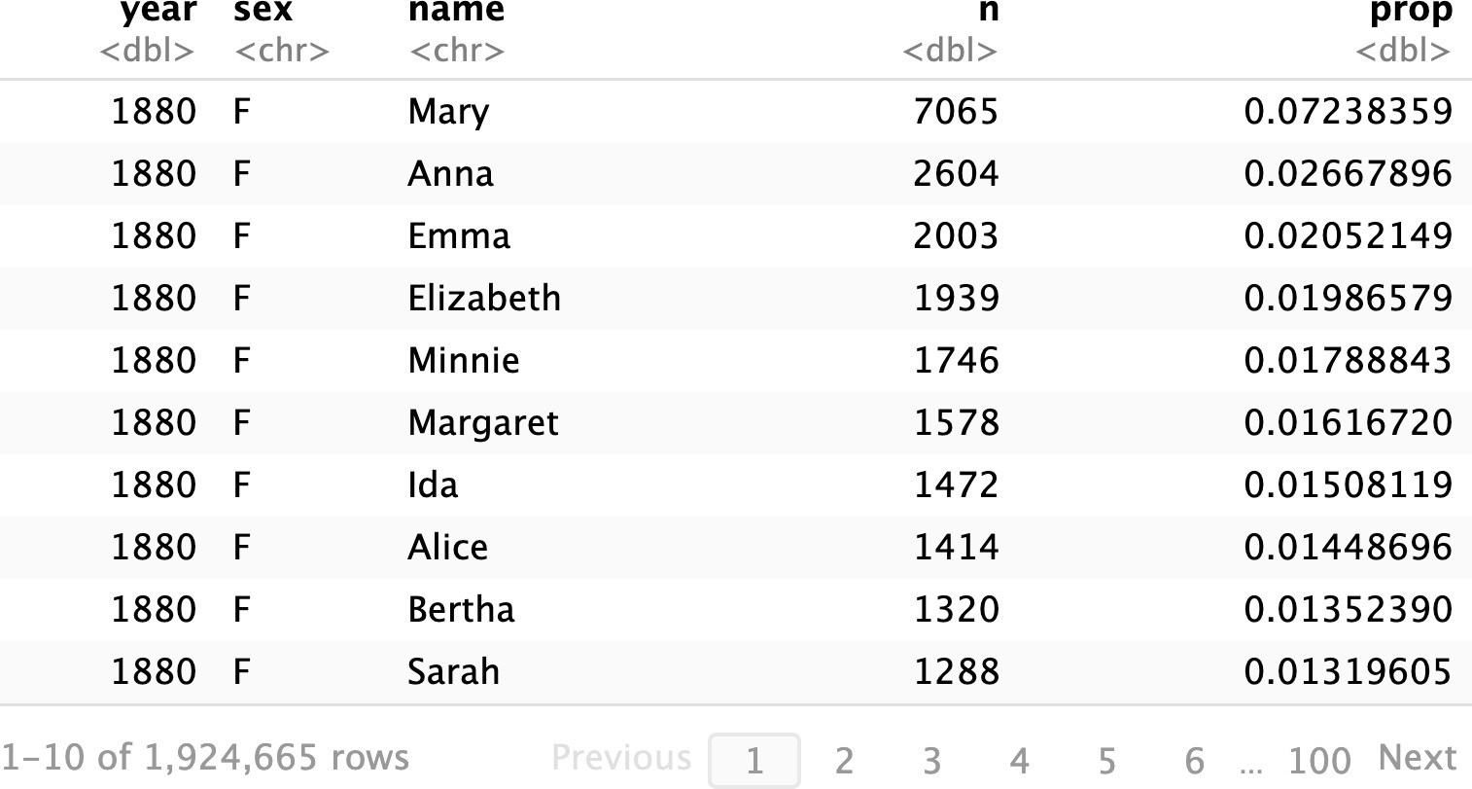
babynames

Slide 9
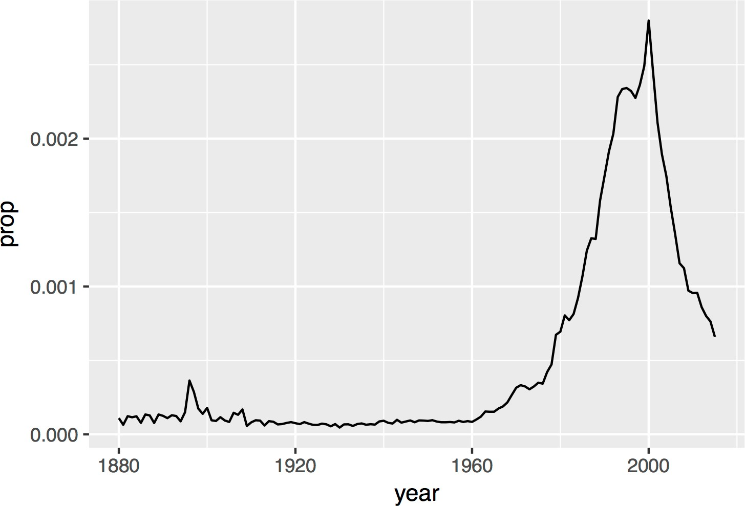
Proportion of boys with the name Garrett

Slide 10

(Applied) Data Science
Visualize
Import
Tidy
Model
Communicate
Transform
5
Program

Slide 11


Import data

Slide 12
babynames.csv
year,sex,name,n,prop 1880,F,Mary,7065,0.07238359
1880,F,Anna,2604,0.02667896
1880,F,Emma,2003,0.02052149
1880,F,Elizabeth,1939,0.01986579
1880,F,Minnie,1746,0.01788843
1880,F,Margaret,1578,0.0161672
1880,F,Ida,1472,0.01508119
1880,F,Alice,1414,0.01448696

Slide 13
babynames.csv
year,sex,name,n,prop 1880,F,Mary,7065,0.07238359
1880,F,Anna,2604,0.02667896
1880,F,Emma,2003,0.02052149
1880,F,Elizabeth,1939,0.01986579
1880,F,Minnie,1746,0.01788843
1880,F,Margaret,1578,0.0161672
1880,F,Ida,1472,0.01508119
1880,F,Alice,1414,0.01448696

Slide 14
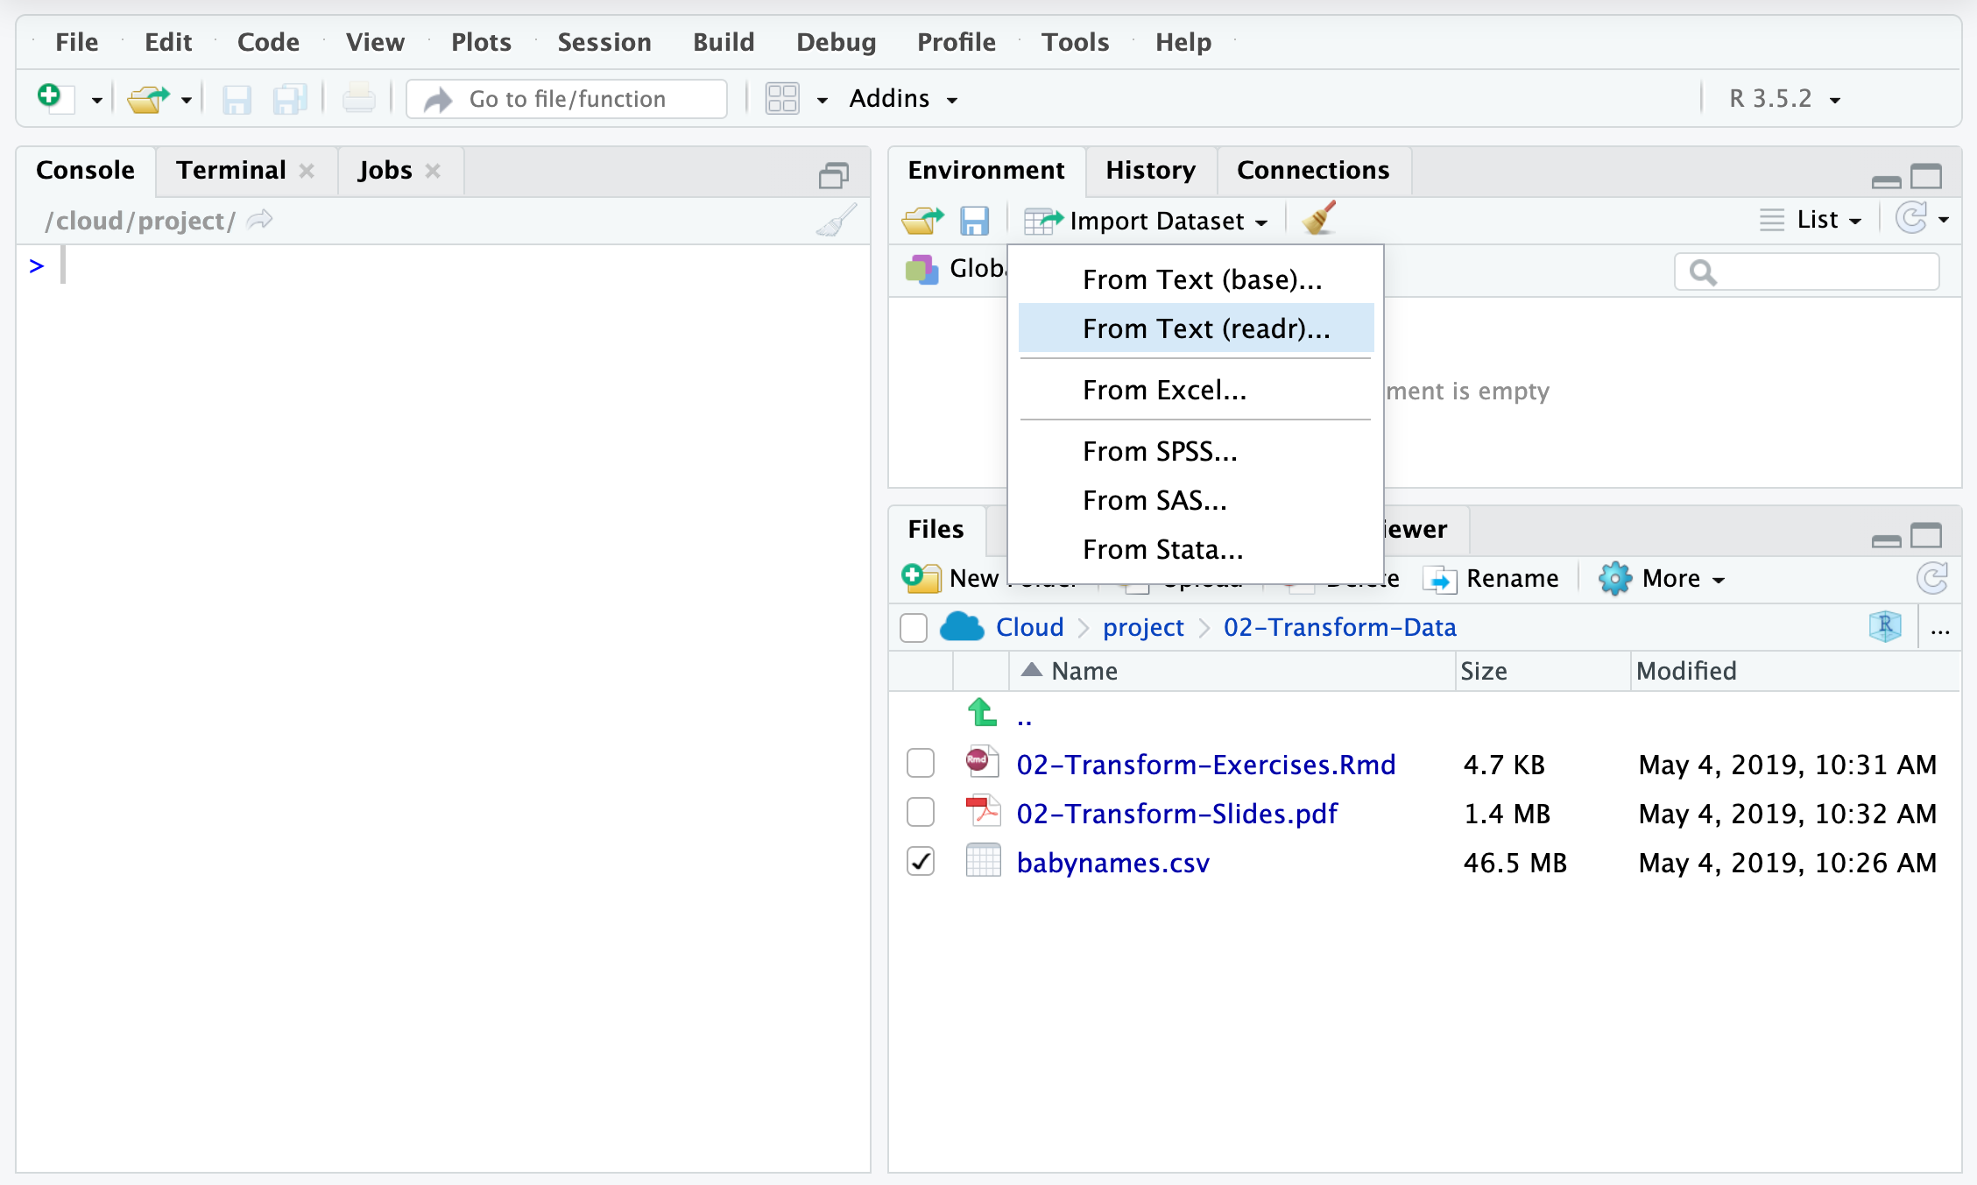
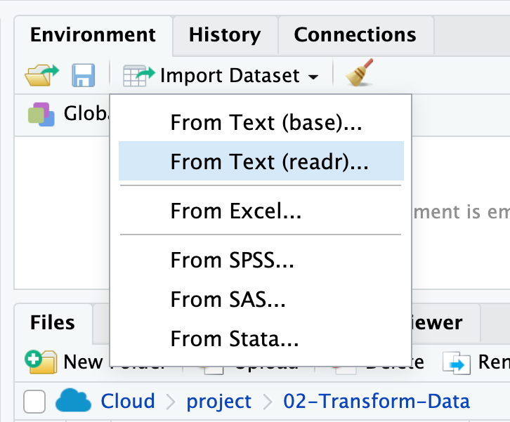
Import
Click Import Dataset From Text (readr)…

Slide 15
Pop Quiz
But is this reproducible?

Slide 16
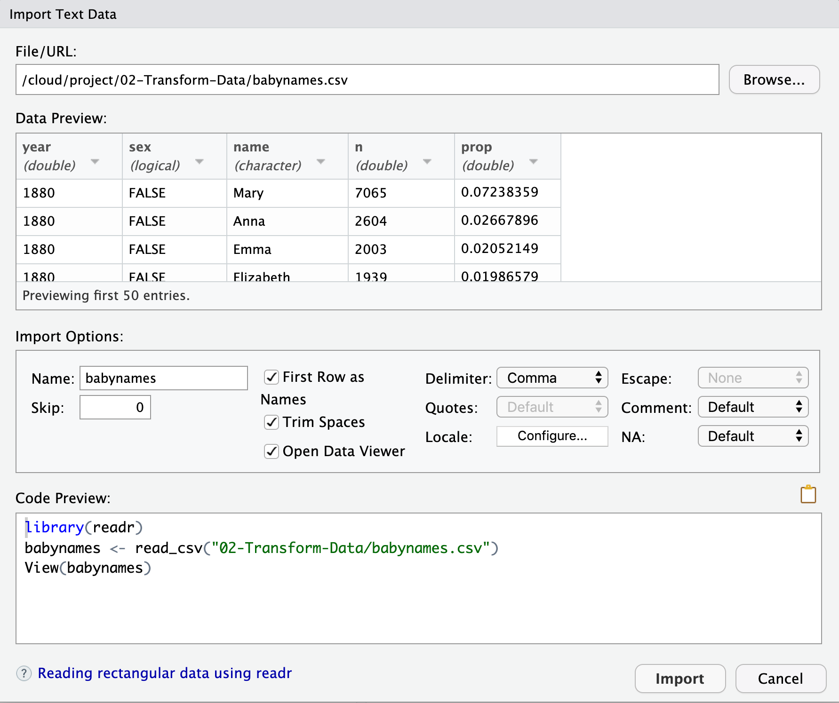
The Code
Equivalent

Slide 17
One
complication!

Slide 18
Working directory
R associates itself with a folder (i.e. directory) on your computer. To see which one, run getwd() at the console.
This folder is known as your "working directory"
When you save files, R will save them here
When you load files, R will look for them here

Slide 19
Quiz
Where R look for files when you call them from an R Markdown document?
.Rmd
≠
Working
Directory
Directory

Slide 20
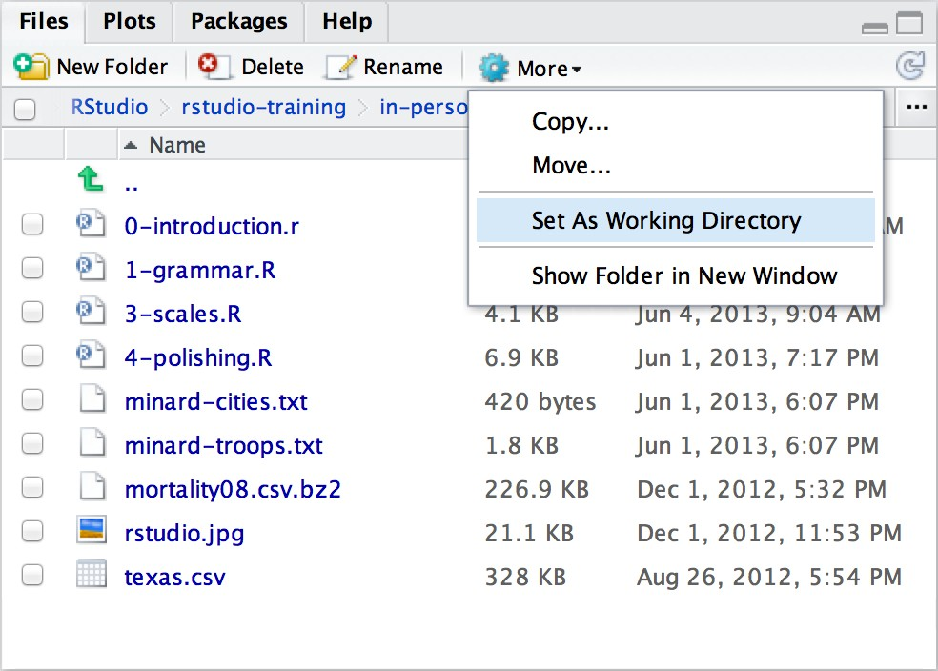
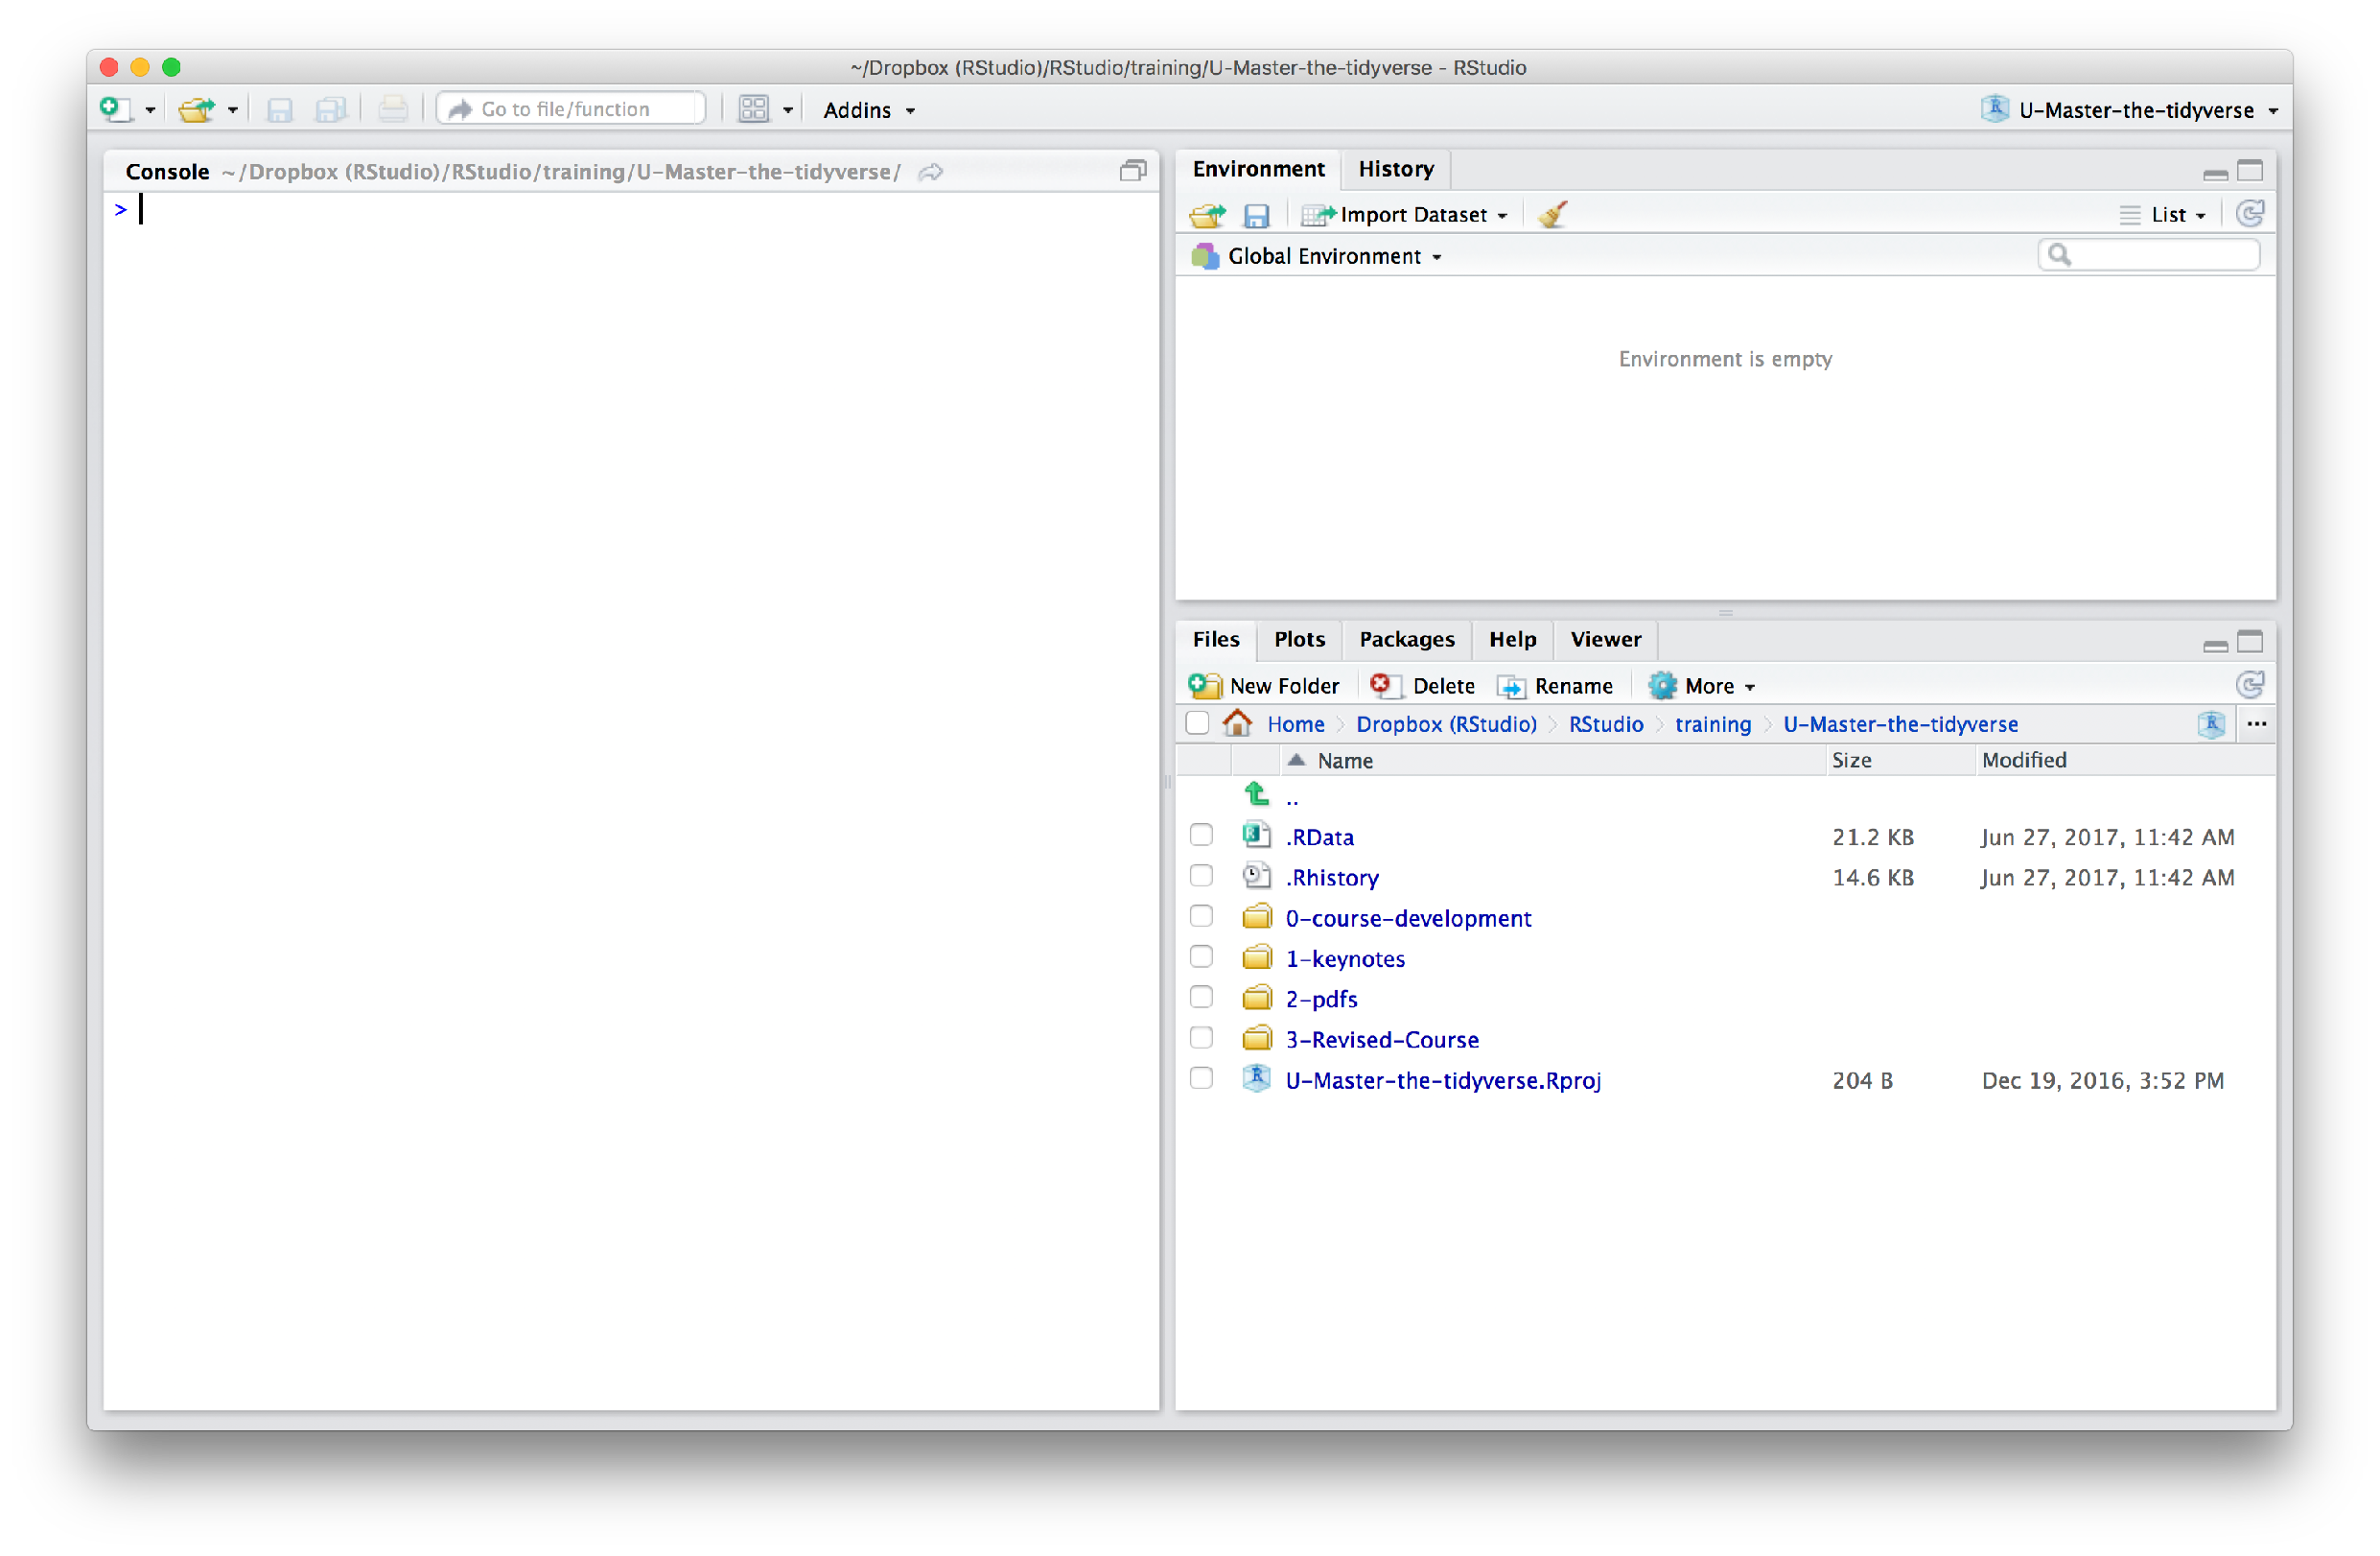
Changing the Working directory
Navigate in the files pane to a new directory. Click More > Set As Working Directory

Slide 21


Set with Projects
Create a project in the directory
File > New Project > Existing Directory > Navigate to Working Directory > Create Project

Slide 22

Your Turn 1
Move your working directory to the 03-Transform folder.
Import the babynames.csv dataset. Give it the name babynames.
Copy the import code into the code chunk in 03-Transform- Exercises (so the document can reload it later).

Slide 23


babynames
Names of male and female babies born in the US from 1880 to 2015. 1.8M rows.
R package
# install.packages("babynames") library(babynames)

Slide 24

write_csv()
Saves data set as a csv on your computer.
write_csv(babynames, path = "babynames.csv")
file
path to save at
Table to save

Slide 25
(Applied) Data Science
Visualize
Import
Tidy
Model
Communicate
Transform
Program

Slide 26
babynames

Slide 27
Proportion of boys with the name Garrett
Which geom?

Slide 28
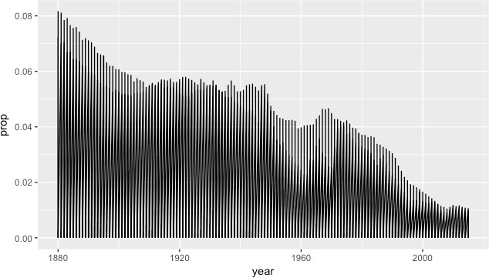
ggplot(data = babynames) +
geom_line(mapping = aes(x = year, y = prop))

Slide 29
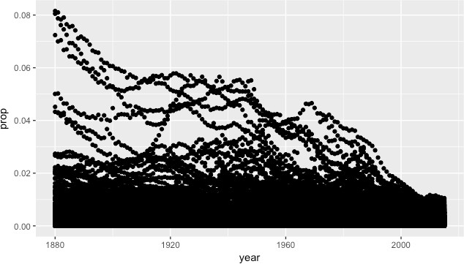
ggplot(data = babynames) +
geom_point(mapping = aes(x = year, y = prop))

Slide 30




0.002
0.002
prop
prop
0.001
0.001
0.000
0.000
1880
1920
year
1960
2000
24
1880
1920
year
1960
2000

Slide 31
How to isolate?
year | sex | name | n | prop
1880 | M | John | 9655 | 0.0815
1880 | M | William | 9532 | 0.0805
1880 | M | James | 5927 | 0.0501
1880 | M | Charles | 5348 | 0.0451
1880 | M | Garrett | 13 | 0.0001
1881 | M | John | 8769 | 0.081
1881 | M | William | 8524 | 0.0787
1881 | M | James | 5442 | 0.0503
1881 | M | Charles | 4664 | 0.0431
1881 | M | Garrett | 7 | 0.0001
1881 | M | Gideon | 7 | 0.0001
year | sex | name | n | prop
1880 | M | Garrett | 13 | 0.0001
1881 | M | Garrett | 7 | 0.0001
… | … | Garrett | … | …
25

Slide 32
dplyr

Slide 33
dplyr
A package that transforms data.
dplyr implements a grammar for transforming tabular data.

Slide 34
Isolating data
select() - extract variables filter() - extract cases
arrange() - reorder cases

Slide 35

select()

Slide 36
select()
Extract columns by name.
select(.data, …)
data frame to transform
name(s) of columns to extract
(or a select helper function)
30

Slide 37
select()
Extract columns by name.
select(babynames, name, prop)
babynames
year | sex | name | n | prop
1880 | M | John | 9655 | 0.0815
1880 | M | William | 9532 | 0.0805
1880 | M | James | 5927 | 0.0501
1880 | M | Charles | 5348 | 0.0451
1880 | M | Garrett | 13 | 0.0001
1881 | M | John | 8769 | 0.081
name | prop
John | 0.0815
William | 0.0805
James | 0.0501
Charles | 0.0451
Garrett | 0.0001
John | 0.081

Slide 38

Your Turn 2
Alter the code to select just the n column:
select(babynames, name, prop)

Slide 39
select(babynames, n)
# |  | n
# |  | <int>
# | 1 | 7065
# | 2 | 2604
# | 3 | 2003
# | 4 | 1939
# | 5 | 1746
# | … | …

Slide 40
select() helpers
: - Select range of columns
select(mpg, cty:class)
- - Select every column but
select(mpg, -c(cty, hwy))
starts_with() - Select columns that start with…
select(mpg, starts_with("c"))
ends_with() - Select columns that end with…
select(mpg, ends_with("y"))

Slide 41
select() helpers
contains() - Select columns whose names contain…
select(mpg, contains("d"))
matches() - Select columns whose names match regular expression
select(mpg, matches("^.{4}$"))
one_of() - Select columns whose names are one of a set
select(mpg, one_of(c("fl", "fuel", "Fuel"))
num_range() - Select columns named in prefix, number style
select(mpg, num_range("x", 1:5))

Slide 42
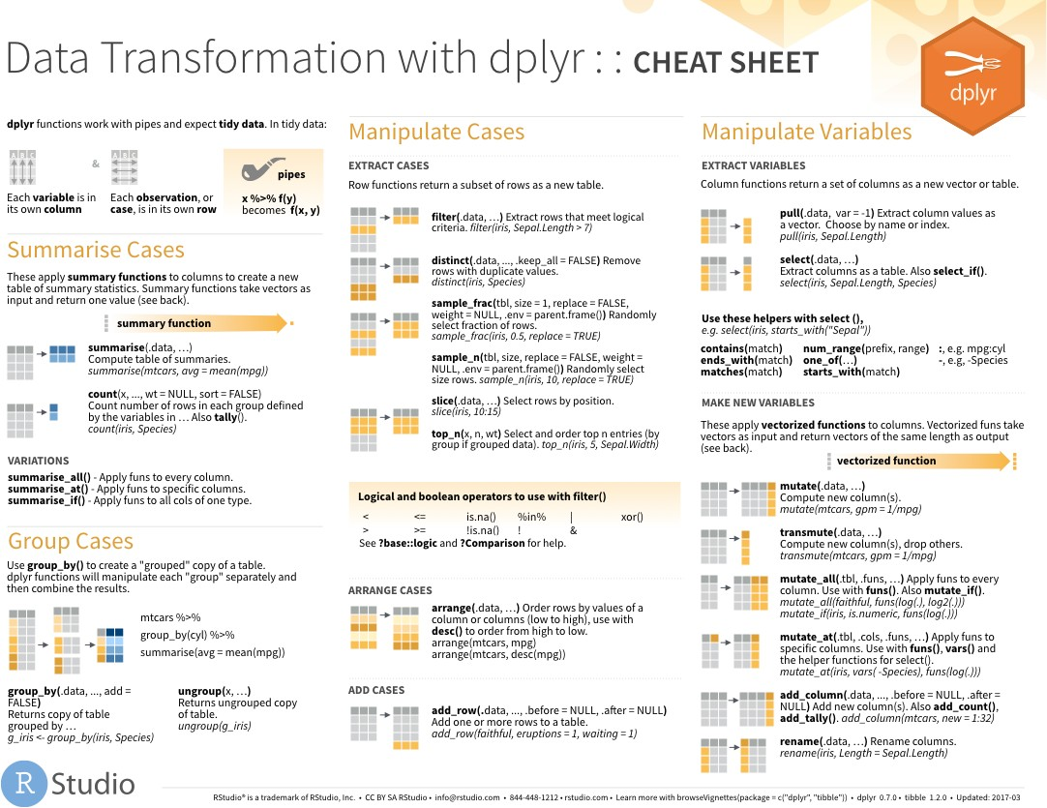
select() helpers
Use these helpers with select (),
e.g. select(iris, starts_with("Sepal"))
contains(match) ends_with(match) matches(match)
num_range(prefix, range) :, e.g. mpg:cyl one_of(…) -, e.g, -Species starts_with(match)

Slide 43
Quiz
Which of these is NOT a way to select the name and n
columns together?
select(babynames, -c(year, sex, prop)) select(babynames, name:n) select(babynames, starts_with("n")) select(babynames, ends_with("n"))

Slide 44
Quiz
Which of these is NOT a way to select the name and n
columns together?
select(babynames, -c(year, sex, prop)) select(babynames, name:n) select(babynames, starts_with("n")) select(babynames, ends_with("n"))

Slide 45
filter()

Slide 46
filter()
Extract rows that meet logical criteria.
filter(.data, … )
one or more logical tests (filter returns each row for which the test is TRUE)
data frame to transform

Slide 47
common syntax
Each function takes a data frame / tibble as its first argument and returns a data frame / tibble.
filter(.data, … )
data frame to transform
function specific arguments
dplyr function

Slide 48
filter()
Extract rows that meet logical criteria.
filter(babynames, name == "Garrett")
babynames
year | sex | name | n | prop
1880 | M | John | 9655 | 0.0815
1880 | M | William | 9532 | 0.0805
1880 | M | James | 5927 | 0.0501
1880 | M | Charles | 5348 | 0.0451
1880 | M | Garrett | 13 | 0.0001
1881 | M | John | 8769 | 0.081
year | sex | name | n | prop
1880 | M | Garrett | 13 | 0.0001
1881 | M | Garrett | 7 | 0.0001
… | … | Garrett | … | …

Slide 49
filter()
Extract rows that meet logical criteria.
filter(babynames, name == "Garrett")
babynames
year | sex | name | n | prop
1880 | M | John | 9655 | 0.0815
1880 | M | William | 9532 | 0.0805
1880 | M | James | 5927 | 0.0501
1880 | M | Charles | 5348 | 0.0451
1880 | M | Garrett | 13 | 0.0001
1881 | M | John | 8769 | 0.081
= sets
(returns nothing)
== tests if equal
(returns TRUE or FALSE)

Slide 50
Logical tests
?Comparison
x < y | Less than
x > y | Greater than
x == y | Equal to
x <= y | Less than or equal to
x >= y | Greater than or equal to
x != y | Not equal to
x %in% y | Group membership
is.na(x) Is NA
!is.na(x) Is not NA

Slide 51
x <- 1
x >= 2 # FALSE

Slide 52
x | <- c(1, 2, | 3)
x # | >= 2 FALSE TRUE | TRUE

Slide 53
Pop Quiz
What might NA stand for?
1
"1"
"one"
NA

Slide 54
Pop Quiz
What might NA stand for?
1
"1"
"one"
NA
Missing Value
(Not Available)

Slide 55
Pop Quiz
What is the result?
1 == 1

Slide 56
Pop Quiz
What is the result?
1 == 1
TRUE

Slide 57
Pop Quiz
What is the result?
1 == NA

Slide 58
Pop Quiz
What is the result?
1 == NA NA

Slide 59
Pop Quiz
What is the result?
NA == NA

Slide 60
Pop Quiz
What is the result?
NA == NA
NA

Slide 61
Pop Quiz
What is the result?
is.na(NA) TRUE

Slide 62
Logical tests
?Comparison
x < y | Less than
x > y | Greater than
x == y | Equal to
x <= y | Less than or equal to
x >= y | Greater than or equal to
x != y | Not equal to
x %in% y | Group membership
is.na(x) | Is NA
!is.na(x) | Is not NA

Slide 63

Your Turn 3
Use filter, babynames, and the logical operators to find:
All of the rows where prop is greater than or equal to 0.08
All of the children named “Sea”

Slide 64
filter(babynames, prop >= 0.08)
# |  | year | sex | name | n | prop
# | 1 | 1880 | M | John | 9655 | 0.08154630
# | 2 | 1880 | M | William | 9531 | 0.08049899
# | 3 | 1881 | M | John | 8769 | 0.08098299
filter(babynames, name == "Sea")
# |  | year | sex | name | n | prop
# | 1 | 1982 | F | Sea | 5 | 2.756771e-06
# | 2 | 1985 | M | Sea | 6 | 3.119547e-06
# | 3 | 1986 | M | Sea | 5 | 2.603512e-06
# | 4 | 1998 | F | Sea | 5 | 2.580377e-06

Slide 65
Two common mistakes
1. Using = instead of ==
filter(babynames, name = "Sea")
filter(babynames, name == "Sea")
2. Forgetting quotes
filter(babynames, | name | == | Sea)
filter(babynames, | name | == | "Sea")

Slide 66
filter()
Extract rows that meet every logical criteria.
filter(babynames, name == "Garrett", year == 1880)
babynames
year | sex | name | n | prop
1880 | M | John | 9655 | 0.0815
1880 | M | William | 9532 | 0.0805
1880 | M | James | 5927 | 0.0501
1880 | M | Charles | 5348 | 0.0451
1880 | M | Garrett | 13 | 0.0001
1881 | M | John | 8769 | 0.081
year | sex | name | n | prop
1880 | M | Garrett | 13 | 0.0001

Slide 67
filter()
Extract rows that meet every logical criteria.
filter(babynames, name == "Garrett" & year == 1880)
babynames
year | sex | name | n | prop
1880 | M | John | 9655 | 0.0815
1880 | M | William | 9532 | 0.0805
1880 | M | James | 5927 | 0.0501
1880 | M | Charles | 5348 | 0.0451
1880 | M | Garrett | 13 | 0.0001
1881 | M | John | 8769 | 0.081
year | sex | name | n | prop
1880 | M | Garrett | 13 | 0.0001

Slide 68
Boolean operators
?base::Logic
a & b | and
a | b | or
xor(a,b) | exactly or
!a | not
( ) | To group tests . & evaluates before |

Slide 69
x >= 2 & x < 3
TRUE & TRUE
TRUE

Slide 70

Your Turn 4
Use Boolean operators to alter the code below to return only the rows that contain:
Boys named Sue
Names that were used by exactly 5 or 6 children in 1880
Names that are one of Acura, Lexus, or Yugo
filter(babynames, name == "Sea" | name == "Anemone")

Slide 71
filter(babynames, name == "Sue", sex == "M")
# | year | sex | name | n | prop
# 1 | 1917 | M | Sue | 7 | 0.0000073
# 2 | 1927 | M | Sue | 5 | 0.0000043
# … | … | … | … | … | …
filter(babynames, (n == 5 | n == 6) & year == 1880)
# year sex name # 1 1880 F Abby
# 2 1880 F Aileen
# … … … …
n prop
6 6.147289e-05
6 6.147289e-05
… …
Parentheses
matter
filter(babynames, name == "Acura" | name =="Lexus" |name =="Yugo")
# year sex name # 1 1990 F Lexus
# 2 1990 M Lexus
# … … … …
n prop
36 1.752932e-05
12 5.579156e-06
… …

Slide 72
Two more common mistakes
3. Collapsing multiple tests into one
filter(babynames, 10 < n < 20)
filter(babynames, 10 < n, n < 20)
4. Stringing together many tests (when you could use %in%)
filter(babynames, n == 5 | n == 6 | n == 7 | n == 8) filter(babynames, n %in% c(5, 6, 7, 8))
66

Slide 73
filter(babynames, name == "Sue", sex == "M")
# year sex name n prop # 1 1917 M Sue 7 0.0000073
# 2 1927 M Sue 5 0.0000043
# … … … … … …
filter(babynames, (n == 5 | n == 6) & year == 1880)
# year sex name n prop # 1 1880 F Abby 6 6.147289e-05
# 2 1880 F Aileen 6 6.147289e-05
# … … … … … …
filter(babynames, name == "Acura" | name =="Lexus" |name =="Yugo")
# | year | sex | name | n | prop
# 1 | 1990 | F | Lexus | 36 | 1.752932e-05
# 2 | 1990 | M | Lexus | 12 | 5.579156e-06
# … | … | … | … | … | …

Slide 74
arrange()

Slide 75
arrange()
Order rows from smallest to largest values.
arrange(.data, …)
one or more columns to order by (additional columns will be used as tie breakers)
data frame to transform

Slide 76
arrange()
Order rows from smallest to largest values.
arrange(babynames, n)
babynames
year | sex | name | n | prop
1880 | M | John | 9655 | 0.0815
1880 | M | William | 9532 | 0.0805
1880 | M | James | 5927 | 0.0501
1880 | M | Charles | 5348 | 0.0451
1880 | M | Garrett | 13 | 0.0001
1881 | M | John | 8769 | 0.081
year | sex | name | n | prop
1880 | M | Garrett | 13 | 0.0001
1880 | M | Charles | 5348 | 0.0451
1880 | M | James | 5927 | 0.0501
1881 | M | John | 8769 | 0.081
1880 | M | William | 9532 | 0.0805
1880 | M | John | 9655 | 0.0815

Slide 77
desc()
Changes ordering to largest to smallest.
arrange(babynames, desc(n))
babynames
year | sex | name | n | prop
1880 | M | John | 9655 | 0.0815
1880 | M | William | 9532 | 0.0805
1880 | M | James | 5927 | 0.0501
1880 | M | Charles | 5348 | 0.0451
1880 | M | Garrett | 13 | 0.0001
1881 | M | John | 8769 | 0.081
year | sex | name | n | prop
1880 | M | John | 9655 | 0.0815
1880 | M | William | 9532 | 0.0805
1881 | M | John | 8769 | 0.081
1880 | M | James | 5927 | 0.0501
1880 | M | Charles | 5348 | 0.0451
1880 | M | Garrett | 13 | 0.0001

Slide 78
Help me
What is the smallest value of n? What is the largest?

Slide 79
arrange(babynames, n, prop)
# | year sex name | n | prop
# | 1 2007 M Aaban | 5 | 2.259872e-06
# | 2 2007 M Aareon | 5 | 2.259872e-06
# | 3 2007 M Aaris | 5 | 2.259872e-06
# | 4 2007 M Abd | 5 | 2.259872e-06
# | 5 2007 M Abdulazeez | 5 | 2.259872e-06
# | 6 2007 M Abdulhadi | 5 | 2.259872e-06
# | 7 2007 M Abdulhamid | 5 | 2.259872e-06
# | 8 2007 M Abdulkadir | 5 | 2.259872e-06
# | 9 2007 M Abdulraheem | 5 | 2.259872e-06
# | 10 2007 M Abdulrahim | 5 | 2.259872e-06
# | … with 1,924,655 more rows

Slide 80
arrange(babynames, desc(n))
# | year sex name | n | prop
# | 1 1947 F Linda | 99680 | 0.05483609
# | 2 1948 F Linda | 96211 | 0.05521159
# | 3 1947 M James | 94763 | 0.05102057
# | 4 1957 M Michael | 92726 | 0.04238659
# | 5 1947 M Robert | 91646 | 0.04934237
# | 6 1949 F Linda | 91010 | 0.05184281
# | 7 1956 M Michael | 90623 | 0.04225479
# | 8 1958 M Michael | 90517 | 0.04203881
# | 9 1948 M James | 88588 | 0.04969679
# | 10 1954 M Michael | 88493 | 0.04279403
# | … with 1,924,655 more | rows

Slide 81
%>%

Slide 82
Steps
boys_2015 <- filter(babynames, year == 2015, sex == "M")
boys_2015 | <- | select(boys_2015, | name, n)
boys_2015 | <- | arrange(boys_2015, | desc(n))
boys_2015
Filter babynames to just boys born in 2015
Select the name and n columns from the result
Arrange those columns so that the most popular names appear near the top.

Slide 83
Steps
boys_2015 <- filter(babynames, year == 2015, sex == "M")
boys_2015 | <- | select(boys_2015, | name, n)
boys_2015 | <- | arrange(boys_2015, | desc(n))
boys_2015

Slide 84
Steps
arrange(select(filter(babynames, year == 2015, sex == "M"), name, n), desc(n))

Slide 85
The pipe operator %>%
%>%
babynames %>% filter( , n == 99680)
Passes result on left into first argument of function on right.
So, for example, these do the same thing. Try it.
filter(babynames, n == 99680) babynames %>% filter(n == 99680)

Slide 86
Pipes
babynames
boys_2015 <- filter(babynames, year == 2015, sex == "M") boys_2015 <- select(boys_2015, name, n)
boys_2015 <- arrange(boys_2015, desc(n)) boys_2015
babynames %>%
filter(year == 2015, sex == "M") %>% select(name, n) %>% arrange(desc(n))

Slide 87
foo_foo <- little_bunny()
foo_foo %>% hop_through(forest) %>% scoop_up(field_mouse) %>% bop_on(head)
vs.
foo_foo2 <- hop_through(foo_foo, forest) foo_foo3 <- scoop_up(foo_foo2, field_mouse) bop_on(foo_foo3, head)

Slide 88


Shortcut to type %>%
Cmd
Ctrl
+
Shift
Shift
+
M (Mac)
M (Windows)
+
+

Slide 89

Your Turn 5
Use %>% to write a sequence of functions that:
Filters babynames to the girls that were born in 2017, then…
Selects the name and n columns, then…
Arranges the results so that the most popular names are near the top.

Slide 90
babynames %>%
filter(year == 2017, sex == "F") %>% select(name, n) %>% arrange(desc(n))
# |  | name | n
# | 1 Emma |  | 19738
# | 2 Olivia |  | 18632
# | 3 Ava |  | 15902
# | 4 Isabella |  | 15100
# | 5 Sophia |  | 14831
# | 6 Mia |  | 13437
# | 7 Charlotte |  | 12893
# | 8 Amelia |  | 11800
# | 9 Evelyn |  | 10675
## | … | with 20,170 | more | rows

Slide 91
Payoff!

Slide 92
Your Turn 6 - Exam
Trim babynames to just the rows that contain your name
and your sex
Trim the result to just the columns that will appear in your graph (not strictly necessary, but useful practice)
Plot the results as a line graph with year on the x axis and prop on the y axis
86

Slide 93
babynames %>%
filter(name == "Garrett", sex == "M") %>% select(year, prop) %>%
ggplot() +
geom_line(mapping = aes(year, prop))
0.002
prop
0.001
0.000
1880
1920
1960
2000
year

Slide 94
Plotting
groups

Slide 95







babynames %>%
filter(name == "Michael") %>% ggplot() +
geom_point(mapping = aes(year, prop))
Did not filter
on SEX
0.04
0.03
0.02
0.01
prop
0.00
1880
1920
1960
2000
year

Slide 96
babynames %>%
filter(name == "Michael") %>% ggplot() +
geom_line(mapping = aes(year, prop))
0.04
0.03
0.02
0.01
prop
0.00
1880
1920
1960
2000
year

Slide 97
babynames %>%
filter(name == "Michael") %>% ggplot() +
geom_line(mapping = aes(year, prop, group = sex))
0.04
0.03
0.02
0.01
prop
0.00
1880
1920
1960
2000
year

Slide 98
babynames %>%
filter(name == "Michael") %>% ggplot() +
geom_line(mapping = aes(year, prop, color = sex))
0.04
0.03
sex
prop
F
0.02
M
0.01
0.00
1880
1920
1960
2000
year

Slide 99
babynames %>% filter(name == "Michael") %>% ggplot() +
geom_line(mapping = aes(year, prop)) + facet_wrap(~ sex)
F M
0.04
0.03
0.02
0.01
0.00
prop
1880
1920
1960
2000
1880
year
1920
1960
2000

Slide 100
What are the most
popular names?

Slide 101
Quiz
Do we have enough information to:
1. Calculate the total number of children with each name?

Slide 102
Deriving information
summarise() - summarise variables group_by() - group cases
mutate() - create new variables

Slide 103
summarise()

Slide 104
summarise()
Compute table of summaries.
babynames %>% summarise(total = sum(n), max = max(n))
babynames
year | sex | name | n | prop
1880 | M | John | 9655 | 0.0815
1880 | M | William | 9532 | 0.0805
1880 | M | James | 5927 | 0.0501
1880 | M | Charles | 5348 | 0.0451
1880 | M | Garrett | 13 | 0.0001
1881 | M | John | 8769 | 0.081
total | max
348120517 | 99686

Slide 105
Your Turn 7
Complete the code to extract the rows where name == "Khaleesi". Then use summarise() and sum() and min() to find:
The total number of children named Khaleesi
The first year Khaleesi appeared in the data

Slide 106
babynames %>%
filter(name == "Khaleesi") %>% summarise(total = sum(n), first = min(year))
# total first # 1 1964 2011
106

Slide 107
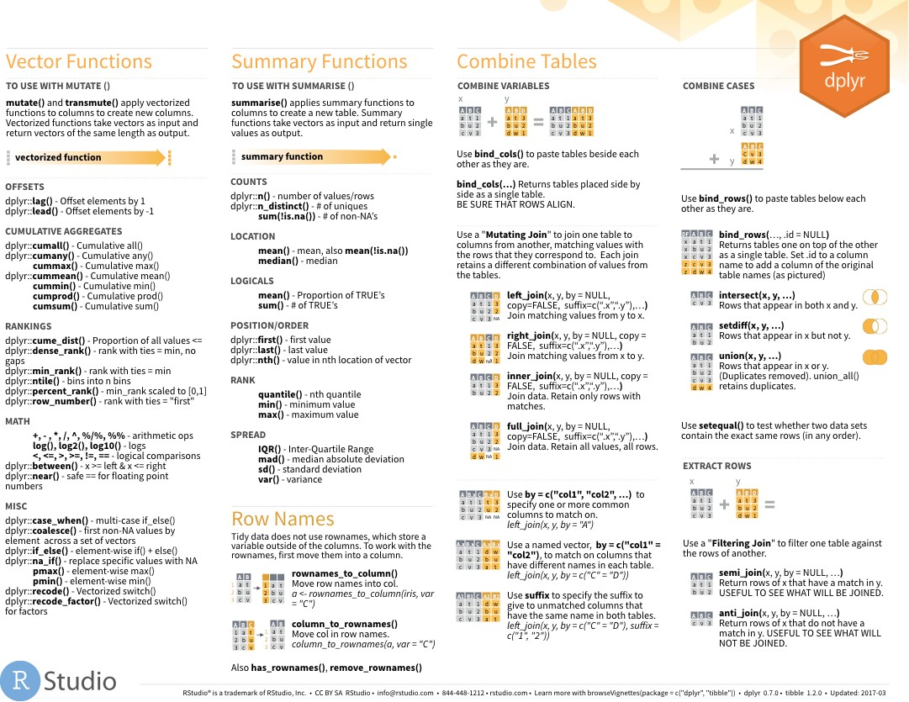

Summary functions
Take a vector as input.
Return a single value as output.
Summary Functions
TO USE WITH SUMMARISE ()
summarise() applies summary functions to columns to create a new table. Summary functions take vectors as input and return single values as output.
summary function COUNTS
dplyr::n() - number of values/rows dplyr::n_distinct() - # of uniques
sum(!is.na()) - # of non-NA’s
LOCATION
mean() - mean, also mean(!is.na()) median() - median
LOGICALS
mean() - Proportion of TRUE’s
sum() - # of TRUE’s
POSITION/ORDER
dplyr::first() - first value dplyr::last() - last value
dplyr::nth() - value in nth location of vector
RANK
quantile() - nth quantile min() - minimum value max() - maximum value
SPREAD
IQR() - Inter-Quartile Range
mad() - median absolute deviation
sd() - standard deviation
var() - variance
on
back
107

Slide 108
n()
The number of rows in a dataset/group
babynames %>% summarise(n = n())
babynames
year | sex | name | n | prop
1880 | M | John | 9655 | 0.0815
1880 | M | William | 9532 | 0.0805
1880 | M | James | 5927 | 0.0501
1880 | M | Charles | 5348 | 0.0451
1880 | M | Garrett | 13 | 0.0001
1881 | M | John | 8769 | 0.081
n
1924665
108

Slide 109
n_distinct()
The number of distinct values in a variable
babynames %>% summarise(n = n(), nname = n_distinct(name))
babynames
year | sex | name | n | prop
1880 | M | John | 9655 | 0.0815
1880 | M | William | 9532 | 0.0805
1880 | M | James | 5927 | 0.0501
1880 | M | Charles | 5348 | 0.0451
1880 | M | Garrett | 13 | 0.0001
1881 | M | John | 8769 | 0.081
n | nname
1924665 | 97310
109

Slide 110
How should we define popularity?
A name is popular if:
1. Sums - a large number of children have the name when you sum across years
110

Slide 111
babynames %>%
filter(name == "Khaleesi" & sex == "F")
## |  | year | sex | name | n | prop
## | 1 | 2011 | F | Khaleesi | 28 | 0.0000145
## | 2 | 2012 | F | Khaleesi | 146 | 0.0000754
## | 3 | 2013 | F | Khaleesi | 243 | 0.000126
## | 4 | 2014 | F | Khaleesi | 369 | 0.000189
## | 5 | 2015 | F | Khaleesi | 341 | 0.000175
## | 6 | 2016 | F | Khaleesi | 371 | 0.000192
## | 7 | 2017 | F | Khaleesi | 466 | 0.000249

Slide 112
babynames %>%
filter(name == "Khaleesi" & sex == "F") %>% summarise(total = sum(n))
## total ## 1 1964
Can we do this for
each name?

Slide 113
Grouping
cases

Slide 114

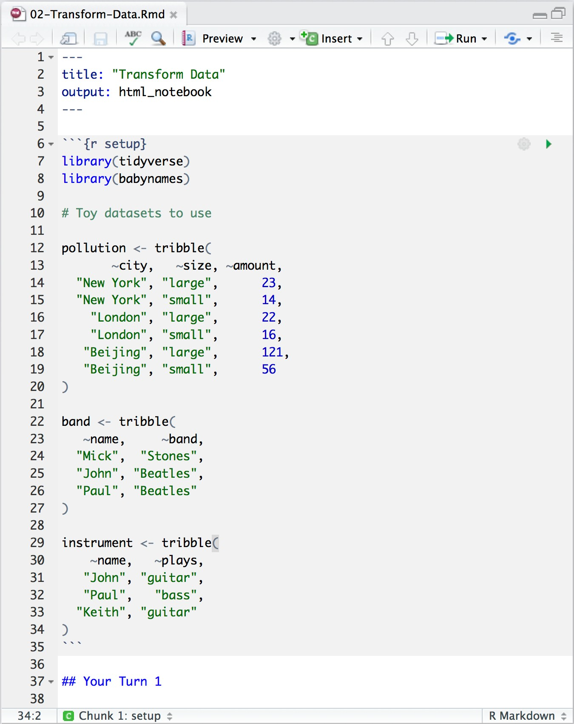

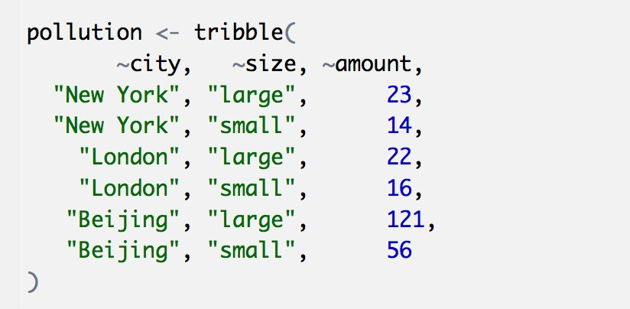
03-Transform-Exercises.Rmd
Toy data sets to practice with

Slide 115
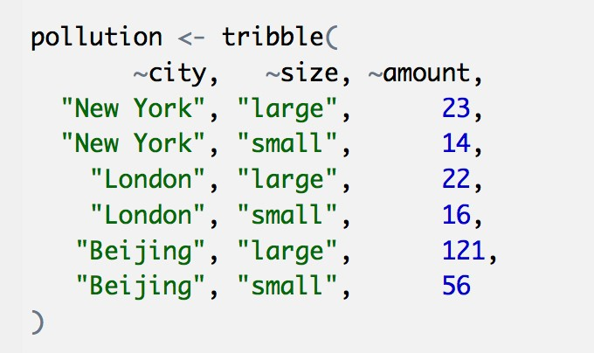
pollution
city | particle size | amount (µg/m³)
New York | large | 23
New York | small | 14
London | large | 22
London | small | 16
Beijing | large | 121
Beijing | small | 56
109

Slide 116
city | particle size | amount (µg/m³)
New York | large | 23
New York | small | 14
London | large | 22
London | small | 16
Beijing | large | 121
Beijing | small | 56
mean | sum | n
42 | 252 | 6
pollution %>%
summarise(mean = mean(amount), sum = sum(amount), n = n())

Slide 117
city | particle size | amount (µg/m³)
New York | large | 23
New York | small | 14
London | large | 22
London | small | 16
Beijing | large | 121
Beijing | small | 56
mean | sum | n
42 | 252 | 6

Slide 118
city | particle size | amount (µg/m³)
New York | large | 23
New York | small | 14
London | large | 22
London | small | 16
Beijing | large | 121
Beijing | small | 56
mean | sum | n
42 | 252 | 6

Slide 119
city | particle size | amount (µg/m³)
New York | large | 23
New York | small | 14
mean | sum | n
18.5 | 37 | 2
mean
sum
n
18.5
37
2
London | large | 22
London | small | 16
19.0 | 38 | 2
19.0
38
2
Beijing | large | 121
Beijing | small | 56
88.5 | 177 | 2
88.5
177
2
group_by() + summarise()

Slide 120
group_by()
Groups cases by common values of one or more columns.
pollution %>% group_by(city)
babynames %>% group_by(sex)
# A tibble: 6 x 3
# Groups: city
<chr>
city [3]
size amount
<chr> <dbl>
23
14
New York large
New York small

Slide 121
group_by()
city | particle size | amount (µg/m³)
New York | large | 23
New York | small | 14
city | particle size | amount (µg/m³)
New York | large | 23
New York | small | 14
London | large | 22
London | small | 16
Beijing | large | 121
Beijing | small | 56
city | mean | sum | n
New York | 18.5 | 37 | 2
London | 19.0 | 38 | 2
Beijing | 88.5 | 177 | 2
London | large | 22
London | small | 16
Beijing | large | 121
Beijing | small | 56
pollution %>% group_by(city) %>%
summarise(mean
=
mean(amount),
sum
=
sum(amount),
n
=
n())

Slide 122
group_by()
city | particle size | amount (µg/m³)
New York | large | 23
city | particle size | amount (µg/m³)
New York | large | 23
New York | small | 14
London | large | 22
London | small | 16
Beijing | large | 121
Beijing | small | 56
city | particle size | mean | sum | n
New York | large | 23 | 23 | 1
New York | small | 14 | 14 | 1
London | large | 22 | 22 | 1
London | small | 16 | 16 | 1
Beijing | large | 121 | 121 | 1
Beijing | small | 56 | 56 | 1
New York | small | 14
London | large | 22
London | small | 16
Beijing | large | 121
Beijing | small | 56
pollution %>% group_by(city, size) %>%
summarise(mean
=
mean(amount),
sum
=
sum(amount),
n
=
n())

Slide 123
group_by()
Groups cases by common values.
babynames %>% group_by(sex) %>% summarise(total = sum(n))
sex | total
F | 172371079
M | 175749438
123

Slide 124
ungroup()
Removes grouping criteria from a data frame.
babynames %>% group_by(sex) %>% ungroup() %>% summarise(total = sum(n))
total
348120517
124

Slide 125
Your Turn 8
Complete the code with group_by(), summarise(),
and arrange() to display the ten most popular name and sex combinations. Compute popularity as the total number of children with a given name and sex.
125

Slide 126
babynames %>% group_by(name, sex) %>%
summarise(total = sum(n)) %>% arrange(desc(total))
# |  | name sex total
# | 1 | James M 5120990
# | 2 | John M 5095674
# | 3 | Robert M 4803068
# | 4 | Michael M 4323928
# | 5 | Mary F 4118058
# | 6 | William M 4071645
# | 7 | David M 3589754
# | 8 | Joseph M 2581785
# | 9 | Richard M 2558165
# | 10 | Charles M 2371621
# | … | with 107,963 more rows

Slide 127
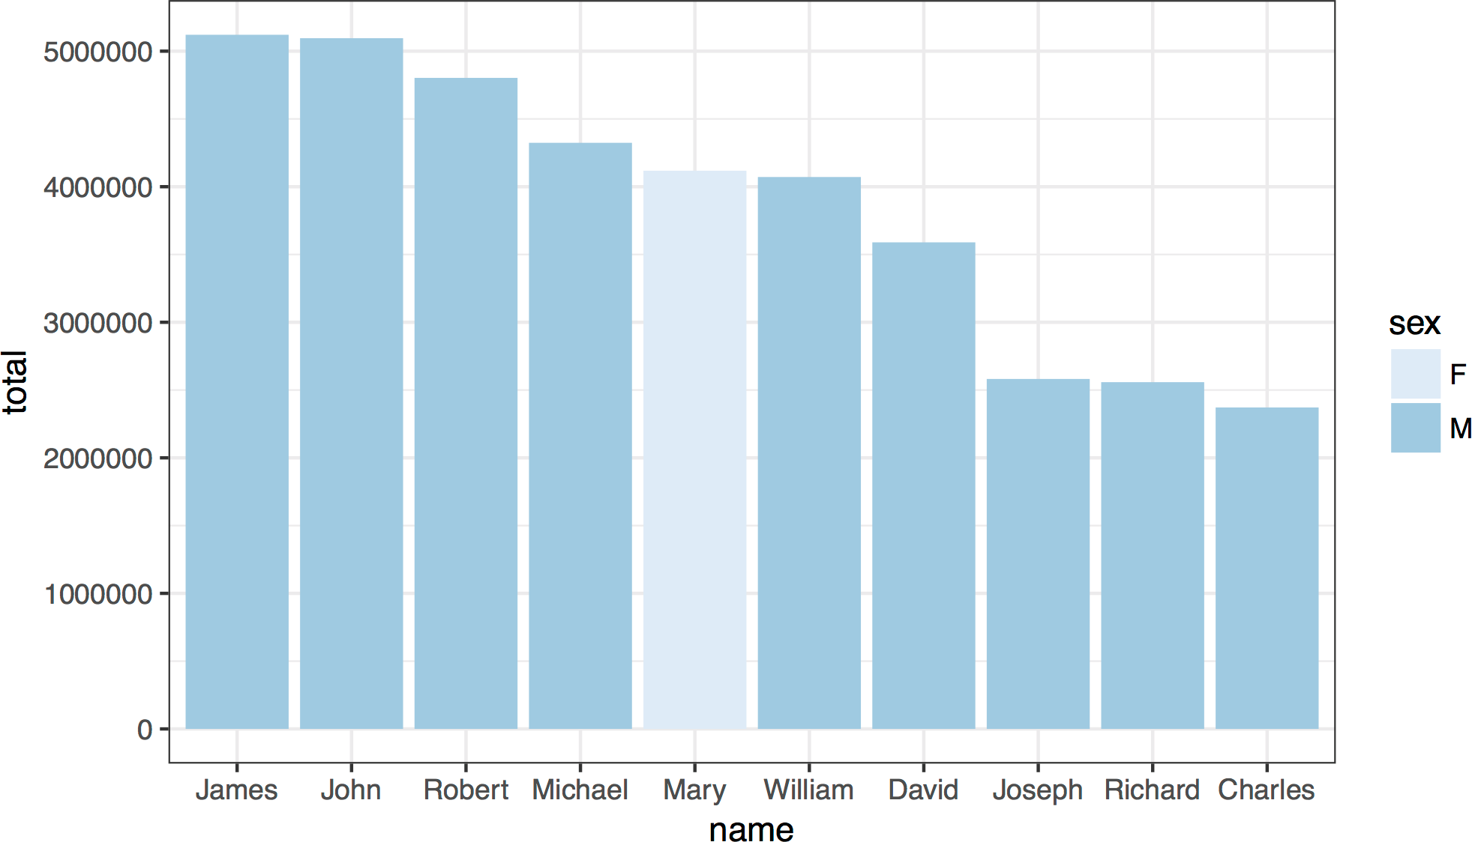

Slide 128
babynames %>% group_by(name, sex) %>%
summarise(total = sum(n)) %>% arrange(desc(total)) %>% ungroup() %>%
slice(1:10) %>% ggplot() +
geom_col(mapping = aes(x = fct_reorder(name,
desc(total)), y = total, fill = sex)) + theme_bw() +
scale_fill_brewer() + labs(x = "name")

Slide 129
babynames %>%
filter(name == "Khaleesi" & sex == "F") %>% summarise(total = sum(n))
## total ## 1 1964
Can we do this for
each name?

Slide 130
babynames %>%
filter(name == "Khaleesi" & sex == "F") %>% summarise(total = sum(n))
## total ## 1 1964
babynames %>% group_by(name, sex) %>%
summarise(total = sum(n)) %>% arrange(desc(total))

Slide 131
babynames %>%
filter(name == "Khaleesi" & sex == "F") %>% summarise(total = sum(n))
Group by the
variables you used to
babynames %>% group_by(name, sex) %>% summarise(total = sum(n))
get your test case

Slide 132
Your Turn 9
Use group_by() to calculate the total number of children born for every year.
Plot the results as a line graph: total vs. year.
132

Slide 133
babynames %>%
group_by(year) %>% summarise(n_children = sum(n)) %>% ggplot() +
geom_line(mapping = aes(x = year, y = n_children))
133

Slide 134
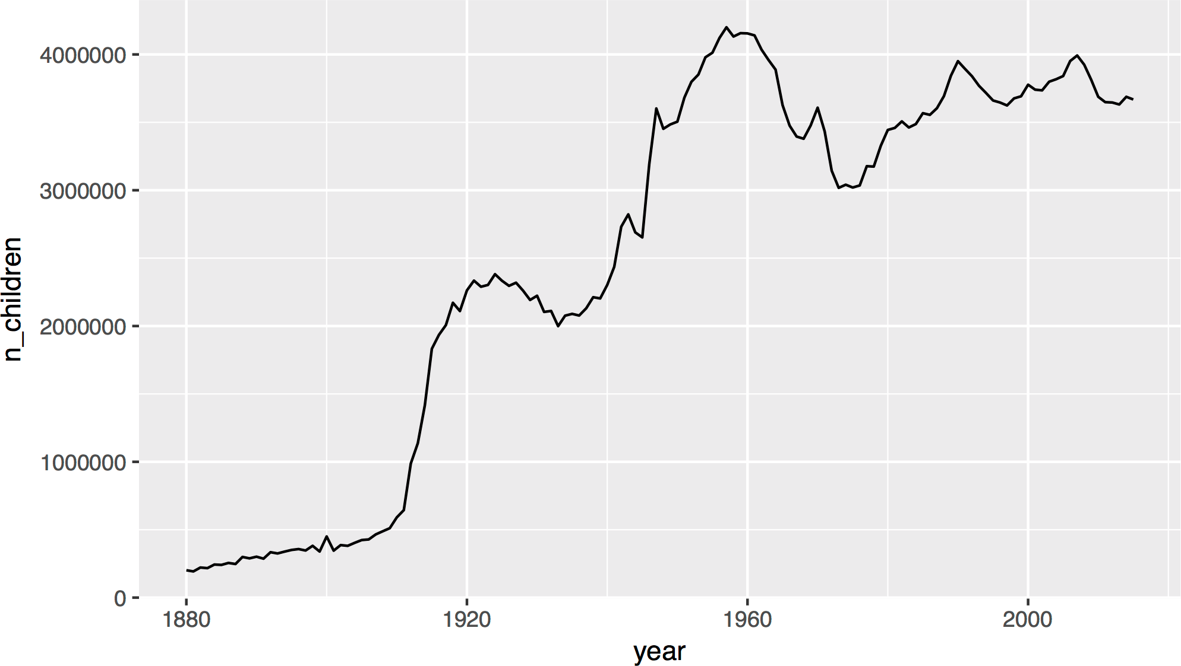
134

Slide 135
What was the top ranked name for each year?

Slide 136
Quiz
Do we have enough information to:
1. Rank names within each year?
130

Slide 137
mutate()

Slide 138
mutate()
Create new columns.
babynames %>%
mutate(percent = round(prop*100, 2))
babynames
year | sex | name | n | prop
1880 | M | John | 9655 | 0.0815
1880 | M | William | 9532 | 0.0805
1880 | M | James | 5927 | 0.0501
1880 | M | Charles | 5348 | 0.0451
1880 | M | Garrett | 13 | 0.0001
1881 | M | John | 8769 | 0.081
year | sex | name | n | prop | percent
1880 | M | John | 9655 | 0.0815 | 8.15
1880 | M | William | 9532 | 0.0805 | 8.05
1880 | M | James | 5927 | 0.0501 | 5.01
1880 | M | Charles | 5348 | 0.0451 | 4.51
1880 | M | Garrett | 13 | 0.0001 | 0.01
1881 | M | John | 8769 | 0.081 | 8.1

Slide 139
mutate()
Create new columns.
babynames %>%
mutate(percent = round(prop*100, 2), nper = round(percent))
babynames
year | sex | name | n | prop
1880 | M | John | 9655 | 0.0815
1880 | M | William | 9532 | 0.0805
1880 | M | James | 5927 | 0.0501
1880 | M | Charles | 5348 | 0.0451
1880 | M | Garrett | 13 | 0.0001
1881 | M | John | 8769 | 0.081
year | sex | name | n | prop | percent | nper
1880 | M | John | 9655 | 0.0815 | 8.15 | 8
1880 | M | William | 9532 | 0.0805 | 8.05 | 8
1880 | M | James | 5927 | 0.0501 | 5.01 | 5
1880 | M | Charles | 5348 | 0.0451 | 4.51 | 5
1880 | M | Garrett | 13 | 0.0001 | 0.01 | 0
1881 | M | John | 8769 | 0.081 | 8.1 | 8

Slide 140
babynames %>% mutate(rank =
?
)

Slide 141

Vectorized functions
Vector Functions
TO USE WITH MUTATE ()
mutate() and transmute() apply vectorized functions to columns to create new columns. Vectorized functions take vectors as input and return vectors of the same length as output.
vectorized function
OFFSETS
dplyr::lag() - Offset elements by 1 dplyr::lead() - Offset elements by -1
CUMULATIVE AGGREGATES
dplyr::cumall() - Cumulative all() dplyr::cumany() - Cumulative any()
cummax() - Cumulative max() dplyr::cummean() - Cumulative mean()
cummin() - Cumulative min() cumprod() - Cumulative prod() cumsum() - Cumulative sum()
RANKINGS
dplyr::cume_dist() - Proportion of all values <= dplyr::dense_rank() - rank with ties = min, no gaps
dplyr::min_rank() - rank with ties = min dplyr::ntile() - bins into n bins dplyr::percent_rank() - min_rank scaled to [0,1] dplyr::row_number() - rank with ties = "first"
MATH
+, - , *, /, ^, %/%, %% - arithmetic ops
log(), log2(), log10() - logs
<, <=, >, >=, !=, == - logical comparisons dplyr::between() - x >= left & x <= right dplyr::near() - safe == for floating point numbers
MISC
dplyr::case_when() - multi-case if_else() dplyr::coalesce() - first non-NA values by element across a set of vectors dplyr::if_else() - element-wise if() + else() dplyr::na_if() - replace specific values with NA
pmax() - element-wise max()
pmin() - element-wise min() dplyr::recode() - Vectorized switch() dplyr::recode_factor() - Vectorized switch() for factors
Take a vector as input.
Return a vector of the same length as output.
on
back
135

Slide 142
min_rank()
A go-to ranking function (ties share the lowest rank)
min_rank(c(50, 100, 100, 1000))
# [1] 1 2 2 4
min_rank(desc(c(50, 100, 100, 1000)))
# [1] 4 2 2 1
136

Slide 143
Your Turn 10
Use mutate() and min_rank() to rank each row in babynames from largest n to lowest n.

Slide 144
babynames %>%
mutate(rank = min_rank(desc(prop)))
## A tibble: 1,924,665 x 6
# |  | year | sex name | n | prop | rank
# | 1 | 1880 | F Mary | 7065 | 0.0724 | 14
# | 2 | 1880 | F Anna | 2604 | 0.0267 | 709
# | 3 | 1880 | F Emma | 2003 | 0.0205 | 1131
# | 4 | 1880 | F Elizabeth | 1939 | 0.0199 | 1192
# | 5 | 1880 | F Minnie | 1746 | 0.0179 | 1427
# | 6 | 1880 | F Margaret | 1578 | 0.0162 | 1683
## | … | with | 1,924,659 more | rows

Slide 145
Your Turn 11
Group babynames by year and then re-rank the data. Filter the results to just rows where rank == 1.

Slide 146
babynames %>% group_by(year) %>%
mutate(rank = min_rank(desc(prop))) %>% filter(rank == 1)
# A tibble: 138 x 6
# Groups: year [138]
 |  | year | sex | name | n | prop | rank
 | 1 | 1880 | M | John | 9655 | 0.0815 | 1
 | 2 | 1881 | M | John | 8769 | 0.0810 | 1
 | 3 | 1882 | M | John | 9557 | 0.0783 | 1
# | … | with | 135 | more rows

Slide 147

Recap: Single table verbs
Extract variables with select()
Extract cases with filter()
Arrange cases, with arrange().
Make tables of summaries with summarise(). Make new variables, with mutate().
141

Slide 148
$

Slide 149
select()
Extract columns by name.
select(babynames, n)
babynames
year | sex | name | n | prop
1880 | M | John | 9655 | 0.0815
1880 | M | William | 9532 | 0.0805
1880 | M | James | 5927 | 0.0501
1880 | M | Charles | 5348 | 0.0451
1880 | M | Garrett | 13 | 0.0001
1881 | M | John | 8769 | 0.081
n
9655
9532
5927
5348
13
8769
Still a
dataframe

Slide 150
$
Extract column contents as a vector.
babynames$n
babynames
year | sex | name | n | prop
1880 | M | John | 9655 | 0.0815
1880 | M | William | 9532 | 0.0805
1880 | M | James | 5927 | 0.0501
1880 | M | Charles | 5348 | 0.0451
1880 | M | Garrett | 13 | 0.0001
1881 | M | John | 8769 | 0.081
9655 9532 5927 5348 …

Slide 151
$
Extract column contents as a vector.
babynames$n
data frame
column name (no quotes)
$
145

Slide 152
pull()
Pipe friendly version of $
babynames %>% pull(n)
babynames
year | sex | name | n | prop
1880 | M | John | 9655 | 0.0815
1880 | M | William | 9532 | 0.0805
1880 | M | James | 5927 | 0.0501
1880 | M | Charles | 5348 | 0.0451
1880 | M | Garrett | 13 | 0.0001
1881 | M | John | 8769 | 0.081
9655 9532 5927 5348 …

Slide 153
Transform Data with
Slides CC BY-SA RStudio

